Slide 2
Bose Connected Music
Cloud Infrastructure, Team, Strategy
Josh West <josh_west@bose.com>
Cloud Architect
Home Entertainment Division

Slide 3
Bose Connected Music Project
Home Entertainment Division
Research and Advanced Development
Product Owner & Manager: Keith Martin
Algorithms and Cloud Experience

Slide 4
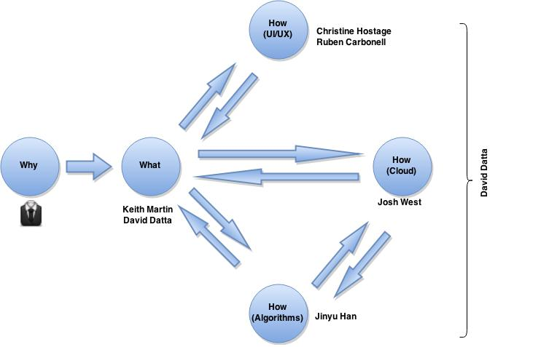
ACE Organization
Notes:
- Why:
- Better music experience for customers
- Increase/diversify product portfolio
- Make money!
- What:
- Smart recommendation engine
- Context aware
- Learn about our customers

Slide 5
What are we doing?
Collecting usage data from multiple sources.
Processing data in [near] real time.
Agnostic API platform for enhanced experience applications to build upon. Examples:
Context aware smart recommendation engine
Playlist generation
Music metadata search

Slide 6
What are we doing?
Preparing for future applications of this system:
Connected Home
Connected Car
Connected Experience. Connected Ecosystem.
Learning about our customers
Market Analytics
Application Usage
Notes:
Learning about our customers:
- Market Analytics
- Application Usage

Slide 7
What are we doing?
Theo: Smart playlist generator (dial in variety)
Trio: Lean back. Three choices for on-to-listen. Expected, recommended and wild card. Based on context and past behavior.
Kaboodle: Party mode group playlist experience.
Web Dashboard: Interact with your experience. Statistics, privacy, and tuning.
Notes:
Also Whizzy

Slide 8
Improve the User Experience!
Notes:
New features and services for customers.
Learn about their usage.
Provide new features to enhance and increase their usage.

Slide 9
How: Cloud
Strategy
DevOps Team
Cloud & App
Infrastructure

Slide 10
How : Cloud : Infrastructure
Introduction to Cloud Computing
Infrastructure as a Service
Amazon Web Services
Pioneered IaaS in 2006 (Xen)
Multiple cloud providers available today:
Microsoft Azure
Google Compute Engine
Rackspace Cloud, HP Helion, etc....

Slide 11
Jeff Bezos AWS Memo
All teams will henceforth expose their data and functionality through service interfaces.
Teams must communicate with each other through these interfaces.
There will be no other form of inter-process communication allowed: no direct linking, no direct reads of another team’s data store, no shared-memory model, no back-doors whatsoever. The only communication allowed is via service interface calls over the network.
It doesn’t matter what technology they use.
All service interfaces, without exception, must be designed from the ground up to be externalizable. That is to say, the team must plan and design to be able to expose the interface to developers in the outside world. No exceptions.
Anyone who doesn’t do this will be fired. Thank you; have a nice day!
Notes:
EVERYTHING AS A SERVICE!
This has lead us to the concept of 'microservices'

Slide 12
Amazon Web Services Concepts
Instance: virtual server
Region: collection of datacenters proximally located network is one fabric (connected)
Availability Zone: datacenter with a region
Billing (usage): cpu time, network traffic, storage, ...

Slide 13
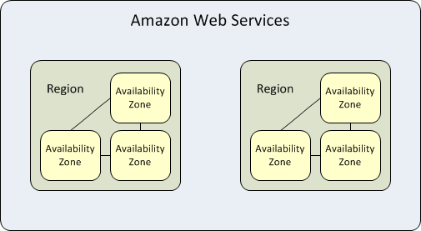
AWS Regions and Availabilty Zones

Slide 14
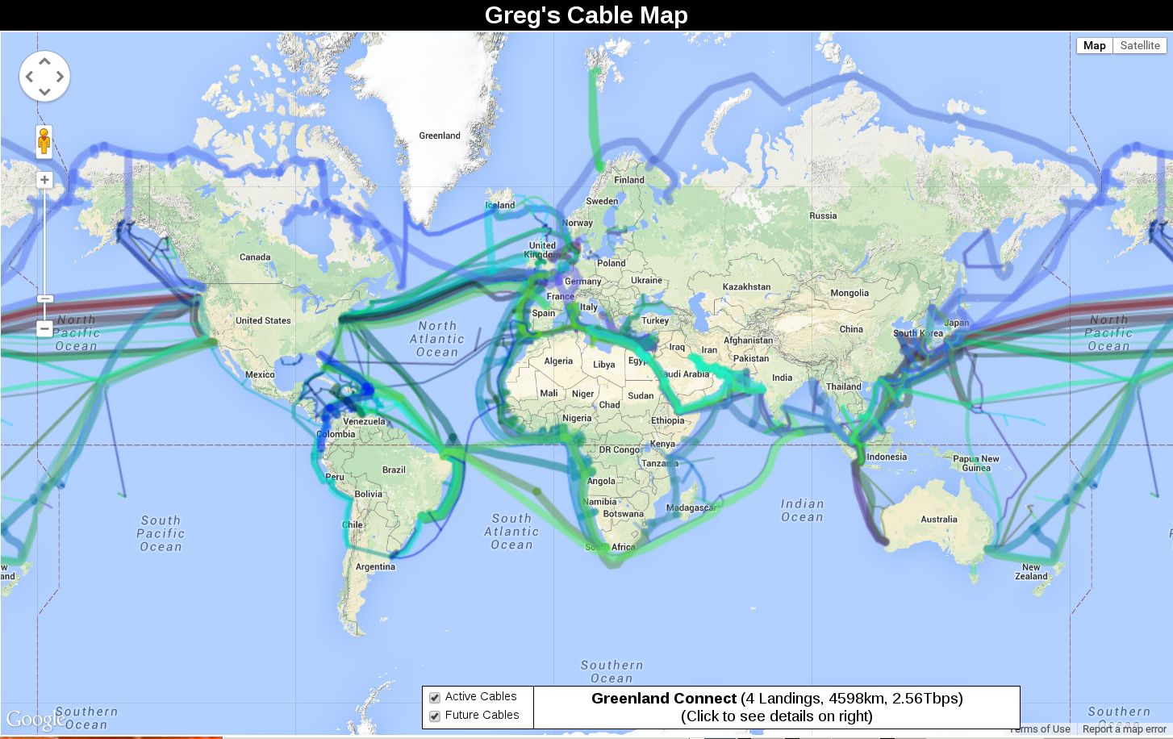
Notes:
- Latency from points across the world can easily be 200ms+
- this is a problem. This is a bad experience.
- Could build datacenters around the world, and then start building BCM system … but hat is a very big CapEx
- IaaS lets us rent capacity around the world without the massive CapEx
- IaaS is much more expensive in the long run but much cheaper (and quicker) in the short term

Slide 15
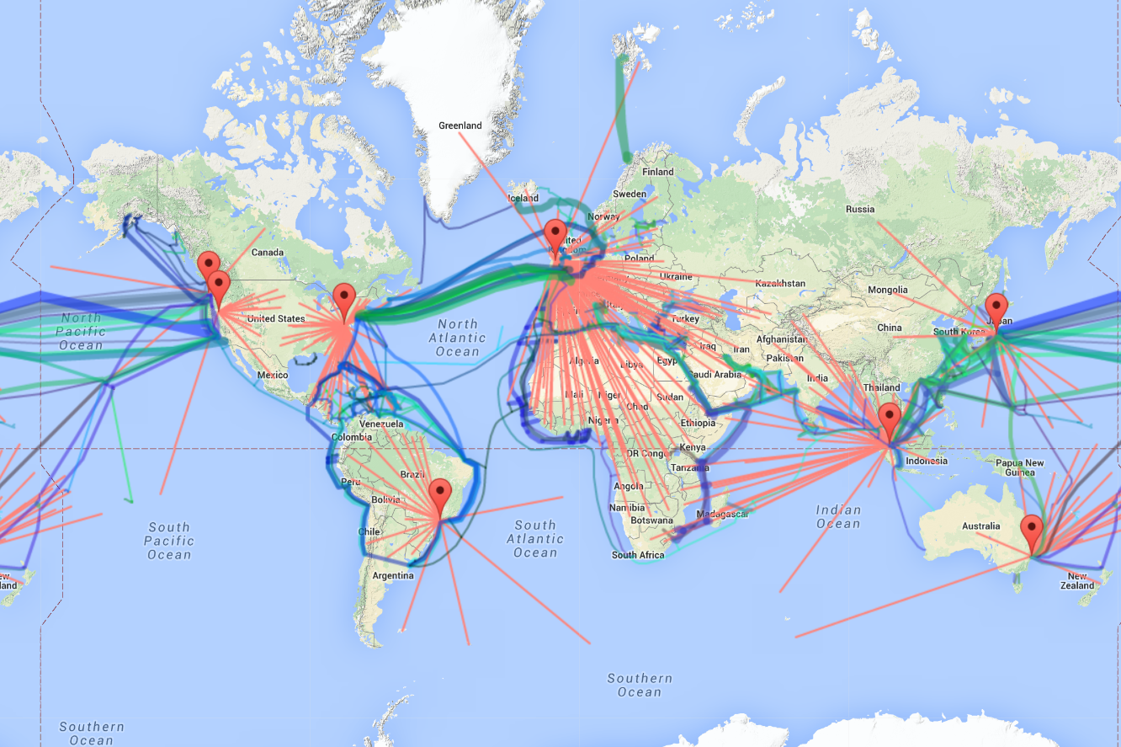

Slide 16
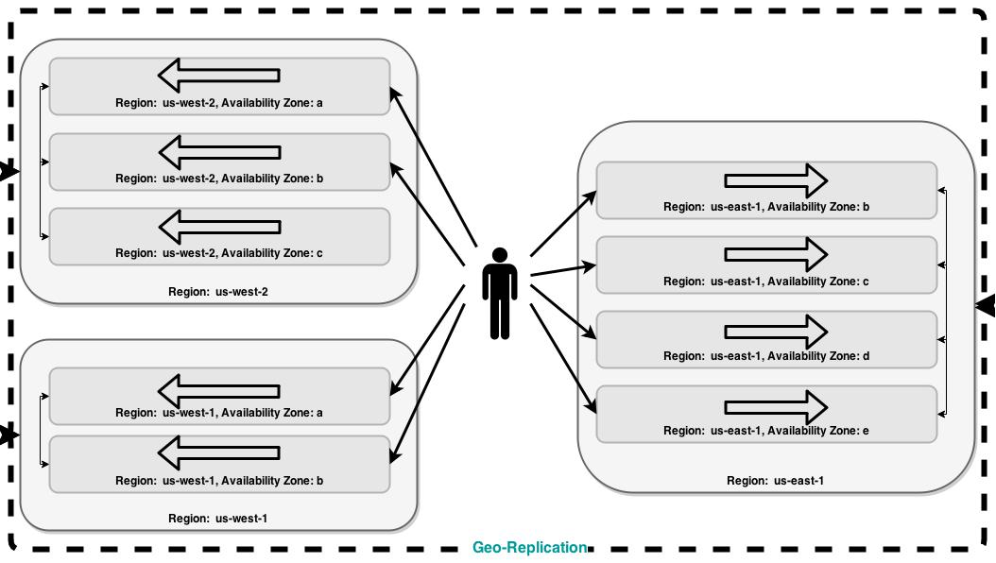

Slide 17
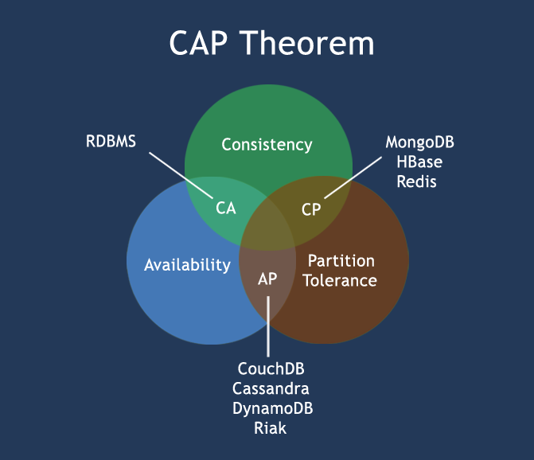
Notes:
In 2000, Eric Brewer conjectured that a distributed system cannot simultaneously provide all three of the following desirable properties:
Consistency: A read sees all previously completed writes.
Availability: Reads and writes always succeed.
Partition tolerance: Guaranteed properties are maintained even when network failures prevent some machines from communicating with others.

Slide 18
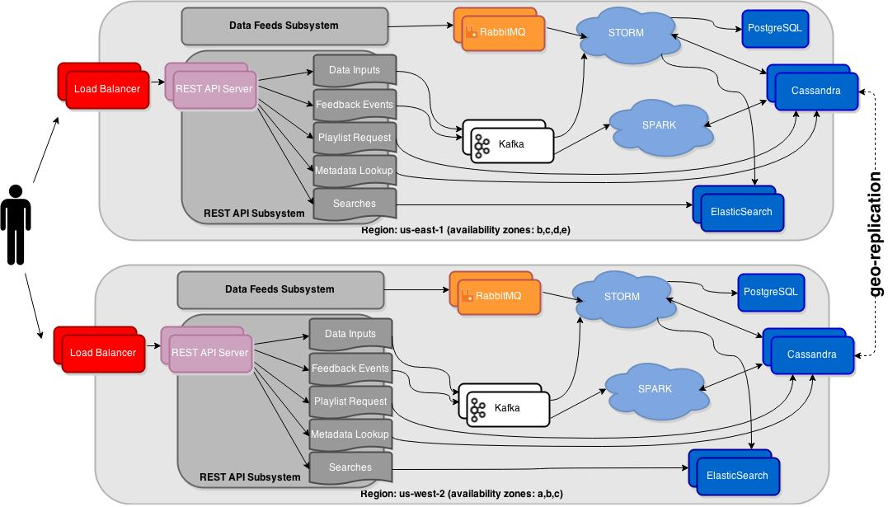

Slide 19
Cloud Environments
Development
Testing
Load Testing
EFE Dedicated?
Production
Main
Analytics
Notes:
These translate directly to collections of interconnected VPCs.

Slide 20
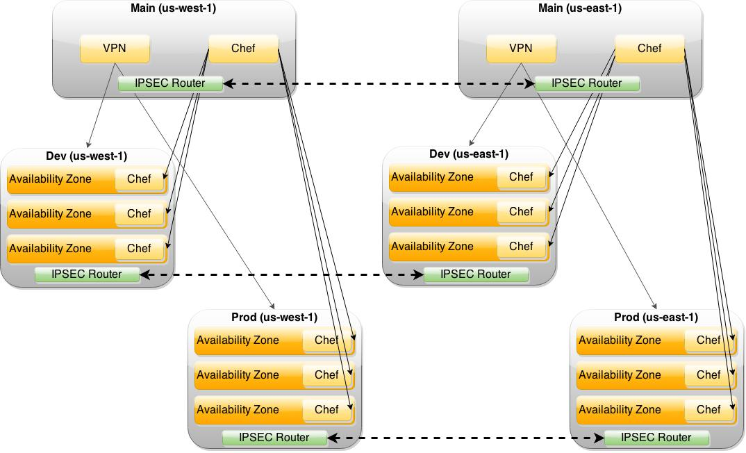

Slide 21
How: Cloud
Strategy
DevOps Team
Cloud & App
Infrastructure

Slide 22
How : Cloud : Team
People!
We are hiring!
6+ open positions for this year
Machine Learning Experts
Cloud Engineering, Big Data, High Availability Rockstars
Consulting firms and experts.
Notes:
- Making our way through software which will support the team.

Slide 23
How: Cloud
Strategy
DevOps Team
Cloud & App
Infrastructure

Slide 24
Cloud Strategy
Enable us to lower risk, tolerate failures
Enable us to be cost/budget sensitive
Enable us to be flexible and portable
Let us build for global scale (and domination)
Open to the future; open to constant change
Strike balance between Not/Invented Here Syndrome
Notes:
Must think about the future. Must build for the future, whatever that may be. Stay 3 steps ahead!
Not just solving the problem at hand right this moment right now!

Slide 25

(Not) Invented Here Syndrome
With invent of {I,P,M,S}aaS, now seeing IHS
Vendor and solution lock-in
Great for start-ups (few people, no time)
We are not a start-up (well, sorta).
We have the expertise to “Do It Right”™

Slide 26
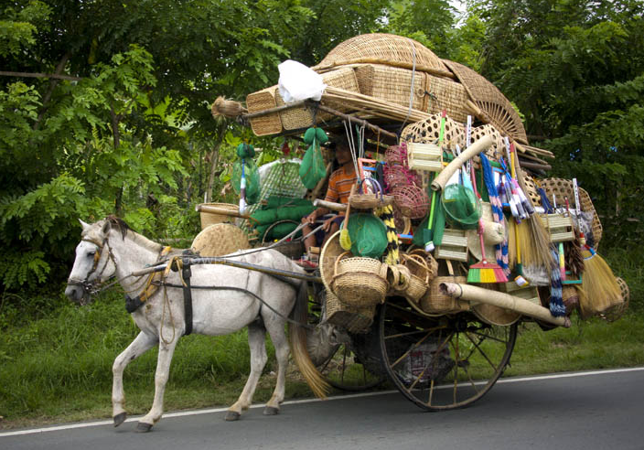
Strategy: Horizonal Scaling

Slide 27



Strategy: Infrastructure as Code
TERRAFORM
Fabric
Cloud Provisioning and Configuration
Server and Service Configuration
Data Loads and Sysadmin Tasks

Slide 28
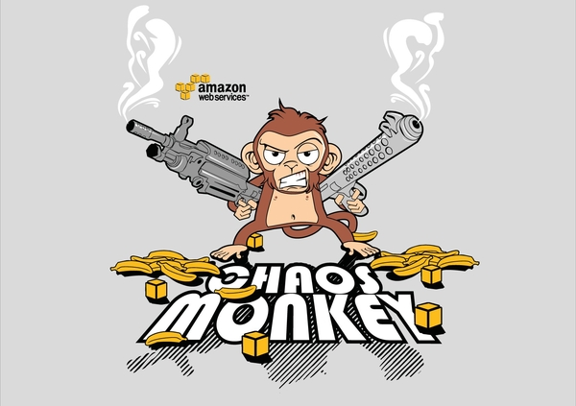
Strategy: Expect Failure!
Notes:
The “cloud” is always on. Orly...?
Azure suffered 40hrs of downtime total in 2014.
Amazon has suffered outages in 2013 and 2014.
Scaling is hard. Uptime is hard. Expect failure.

Slide 29
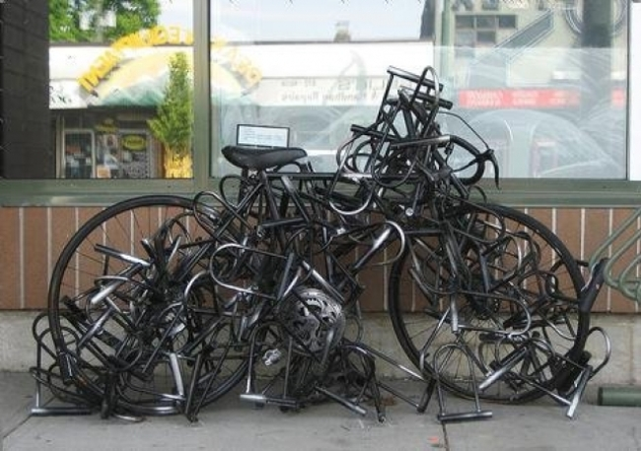
Strategy: Security
Notes:
Security is a process and not just something you tack on at the end
Must build security throughout entire stack
Data at rest, in use, in transit
Encryption, Auditing, Access Controls

Slide 30
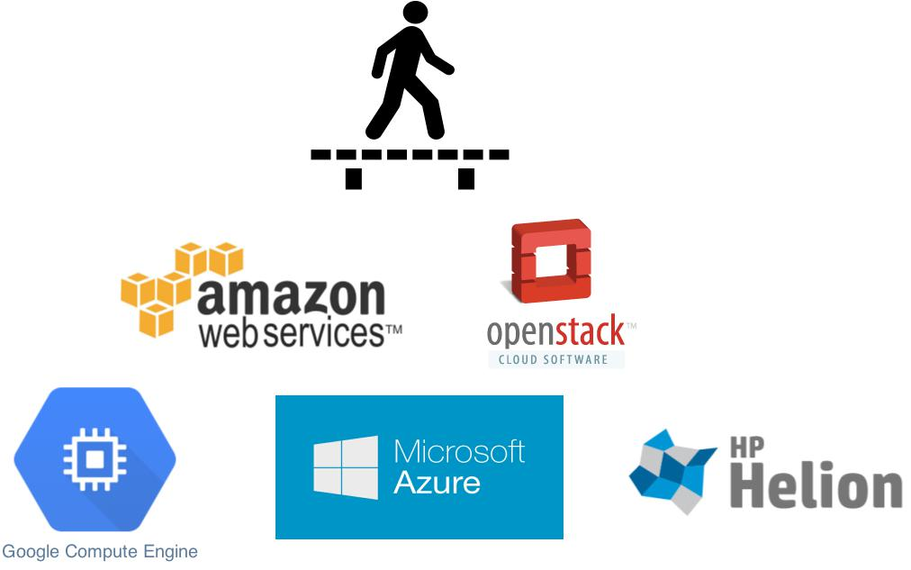
Strategy: Cross Cloud Provider (Hybrid)
Notes:
Cloud Strategy: Build across provider platforms
- Build cloud & app infrastructure to be portable
- Avoid vendor lockin, but find the right balance
- Nothing worse than a rigid infrastructure that cannot be modified without a full rebuild/redesign/redeploy.
- Not the times we live in anymore and we must remain flexible.
- Cloud landscape is in a boom. Rapidly evolving.
- Must remain open to change once the dust settles.
- And related to the 'expect failure' strategy component, we will run across multiple cloud providers. If one has an issue, we will take it out of service.

Slide 31
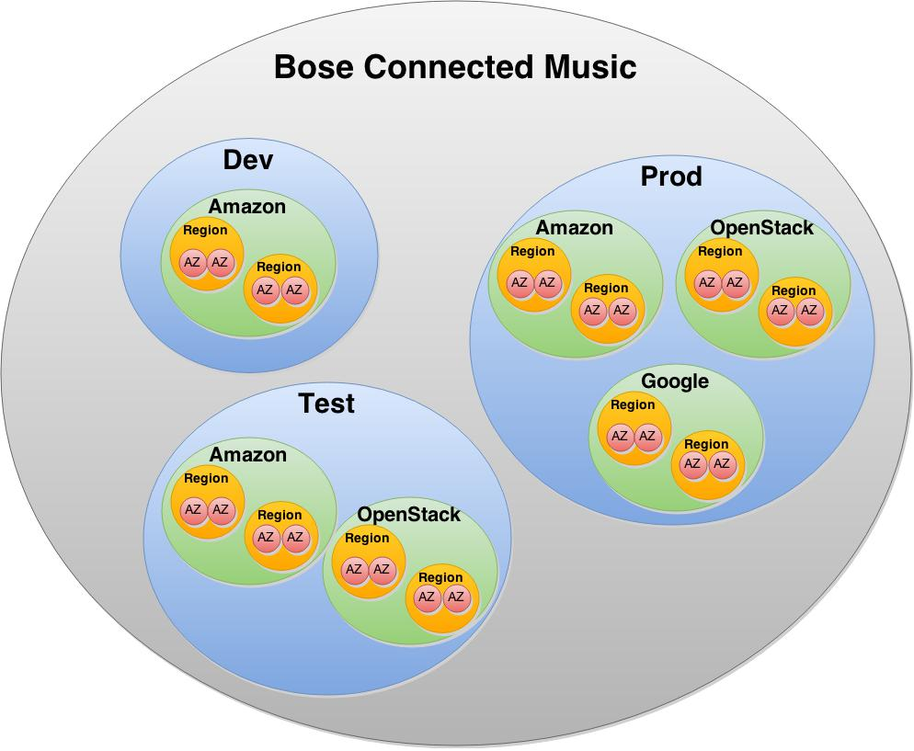

Slide 32

Notes:
Arbitrage!
We can take advantage of pricing differences in different cloud providers across the globe, at different times.

Slide 33
Questions?

